Slide 1
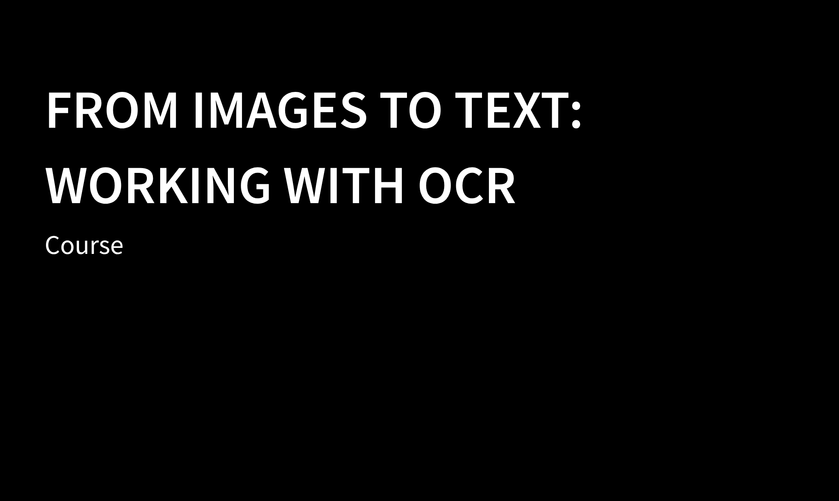

Instructors Joy Lan PhD Candidate Moray House

Slide 2
Arrangements for
the COURSE

Slide 3
Time | Session 1 28th October (Wed) 10:00-12:00 | Session 2 4th November (Wed) 10:00-12:00
Topic | Introduction to OCR Activity: OCR tools – Immarkus Challenges of OCR in practice | Review of programming basics Introduction to OCR packages Working with OCR in Python & R

Slide 4
Introduction to OCR

Slide 5
Optical Character Recognition
OCR is the technique to process images of text, such as written or printed documents, and produce machine-readable documents.

Slide 6
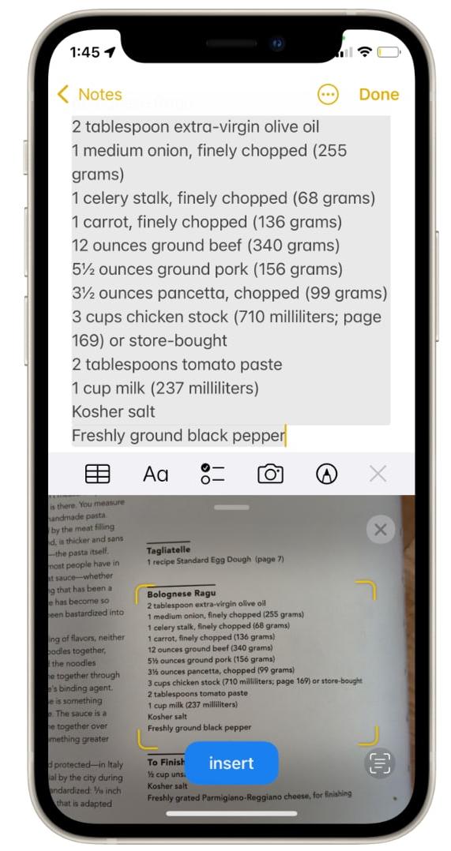

Examples
Scanning your passport at the airport.
Generate machine-readable text for text-to-speech technology.
Making physical archives searchable.
Creating a dataset of for text mining or text analysis.

Slide 7
OCR Workflow
Select the images to be scanned
Scan the images with OCR software
Inspect and 'clean' the processed files
Save the results for further use

Slide 8
Activity 1 - Ready made OCR tool

Slide 9
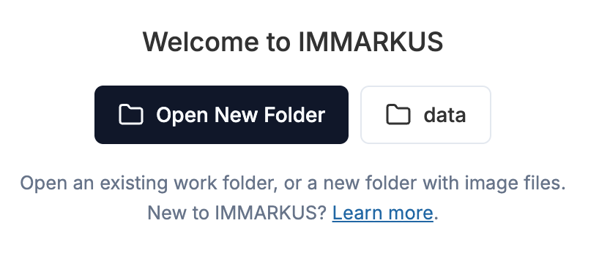
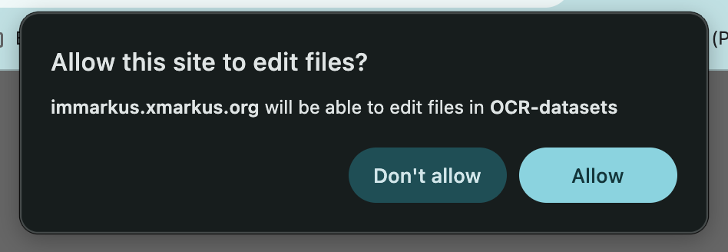
Activity – Out of the box tools
Download the dataset from github repo
Go to https://immarkus.xmarkus.org/
Click on Open New Folder, select the folder ”OCR dataset”
Click “allow”

Slide 10
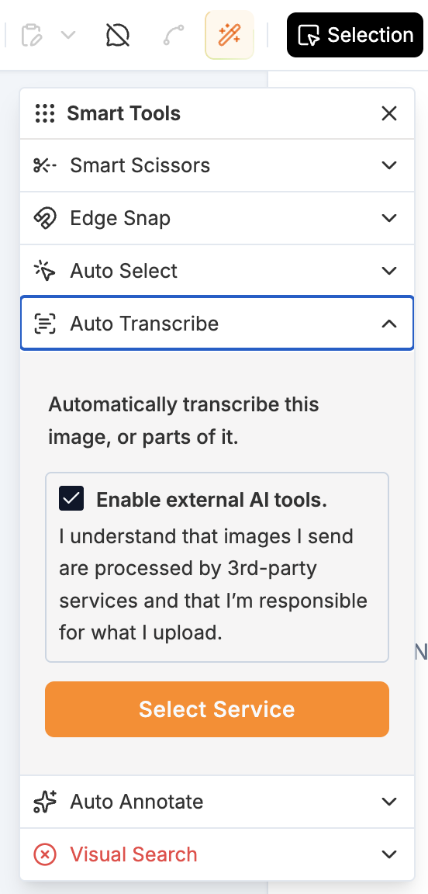
Activity – Out of the box tools
Click on the magic wand icon
Auto Transcribe
Check enable external AI tools
Select Service

Slide 11
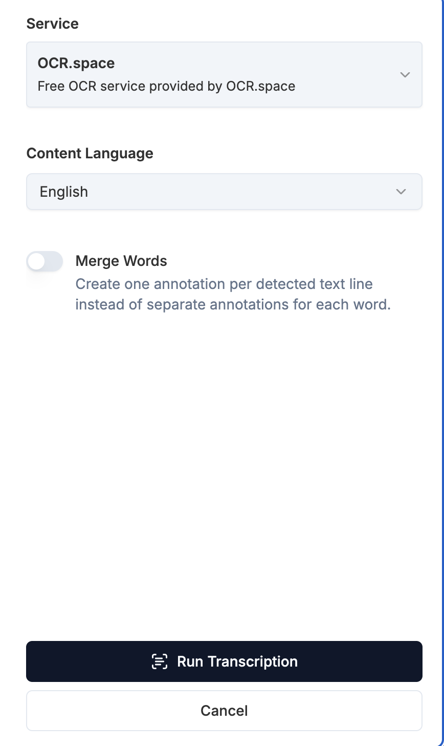
Activity – Out of the box tools
Select OCR.space (free)
Choose content language
Run Transcription
Import to Immarcus

Slide 12
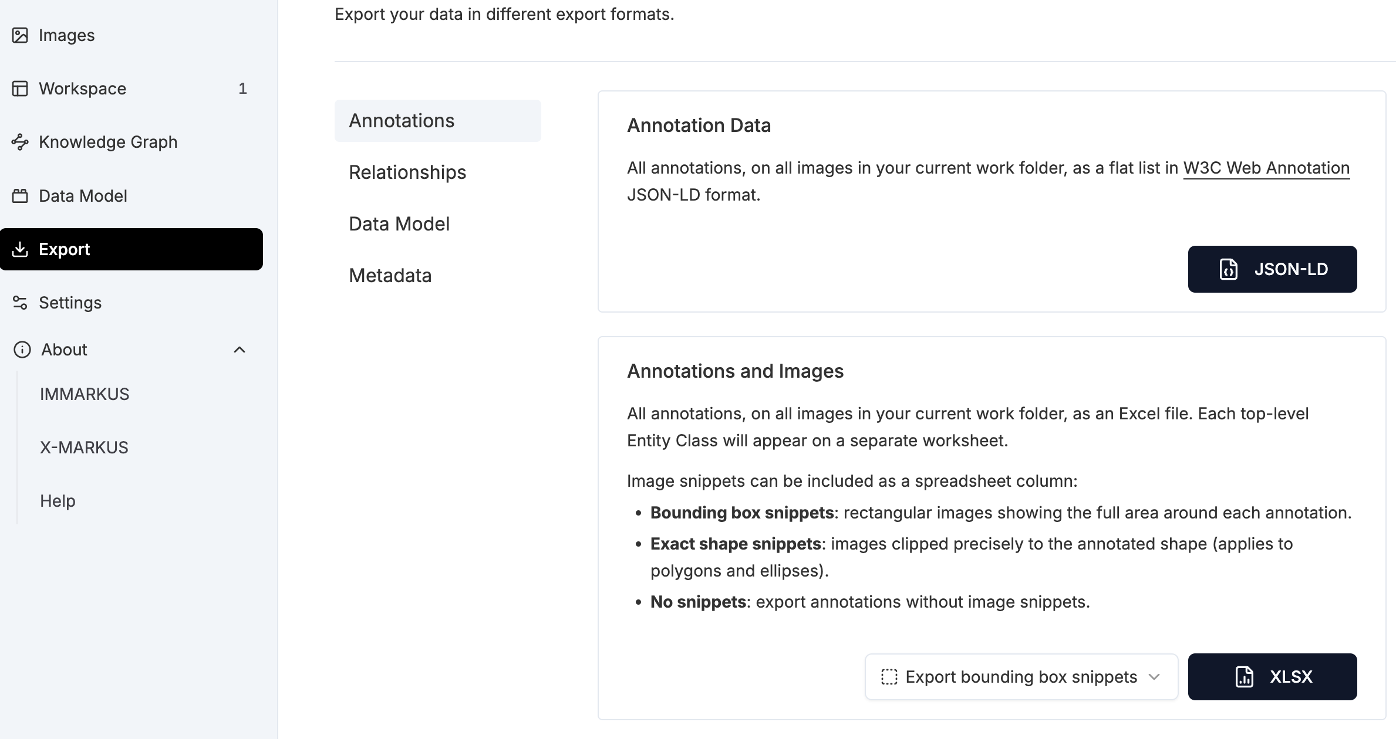
Activity – Out of the box tools
Export
Select XLSX

Slide 13
Challenges of OCR
Accuracy depends on dataset quality. Some common sources of error include:
Age and damage (stained or blurry)
Mixed text and images, or multiple languages
Handwriting
Human errors and typos

Slide 14
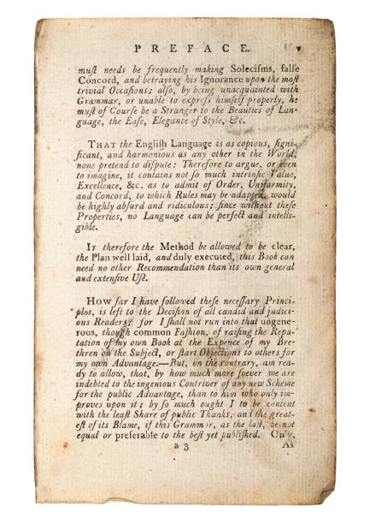
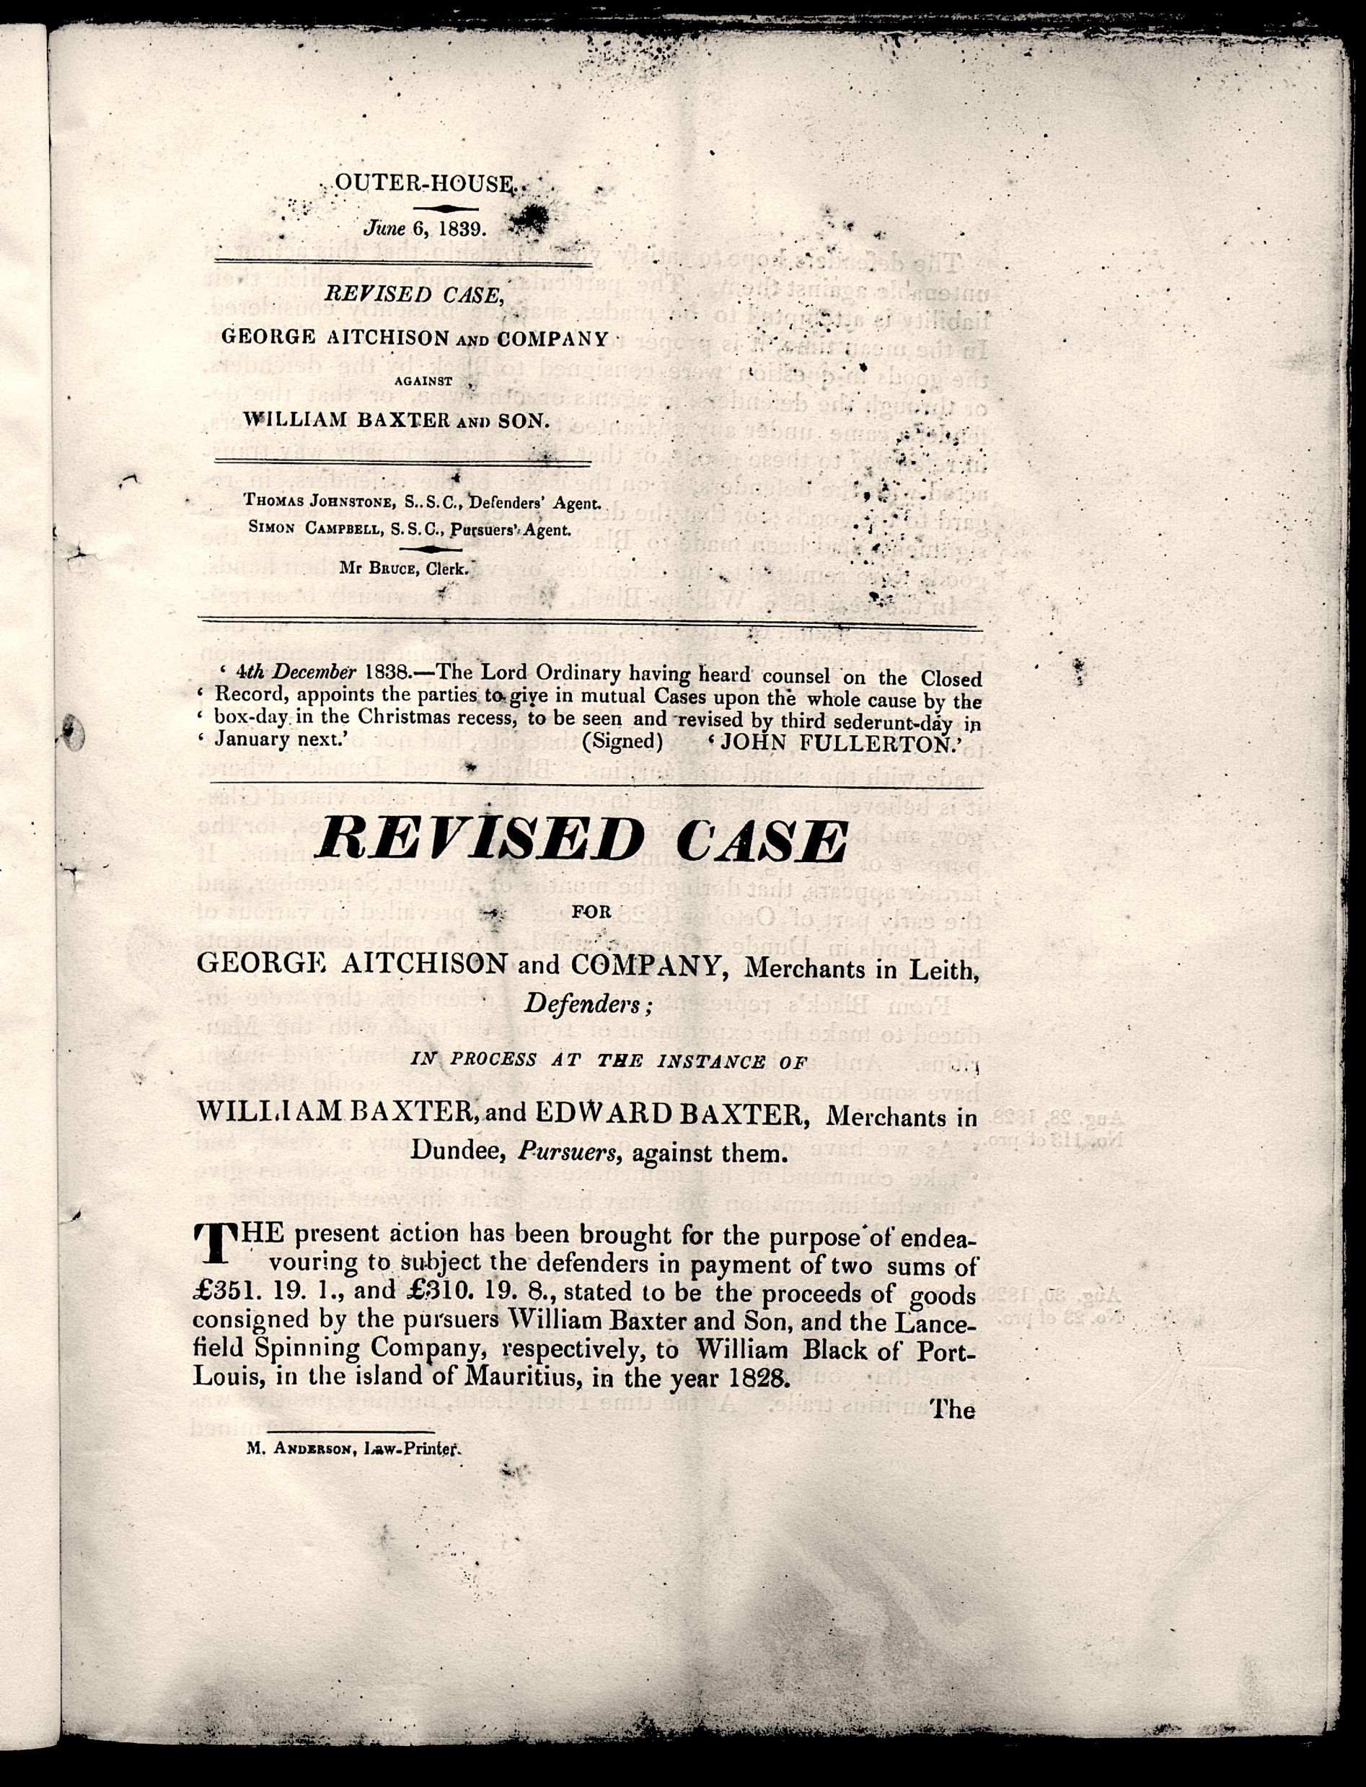
Damaged archive

Slide 15
Challenges of OCR
Accuracy depends on dataset quality. Some common sources of error include:
Age and damage (stained or blurry)
Mixed text and images, or multiple languages
Cursive fonts, handwriting
Human errors and typos

Slide 16
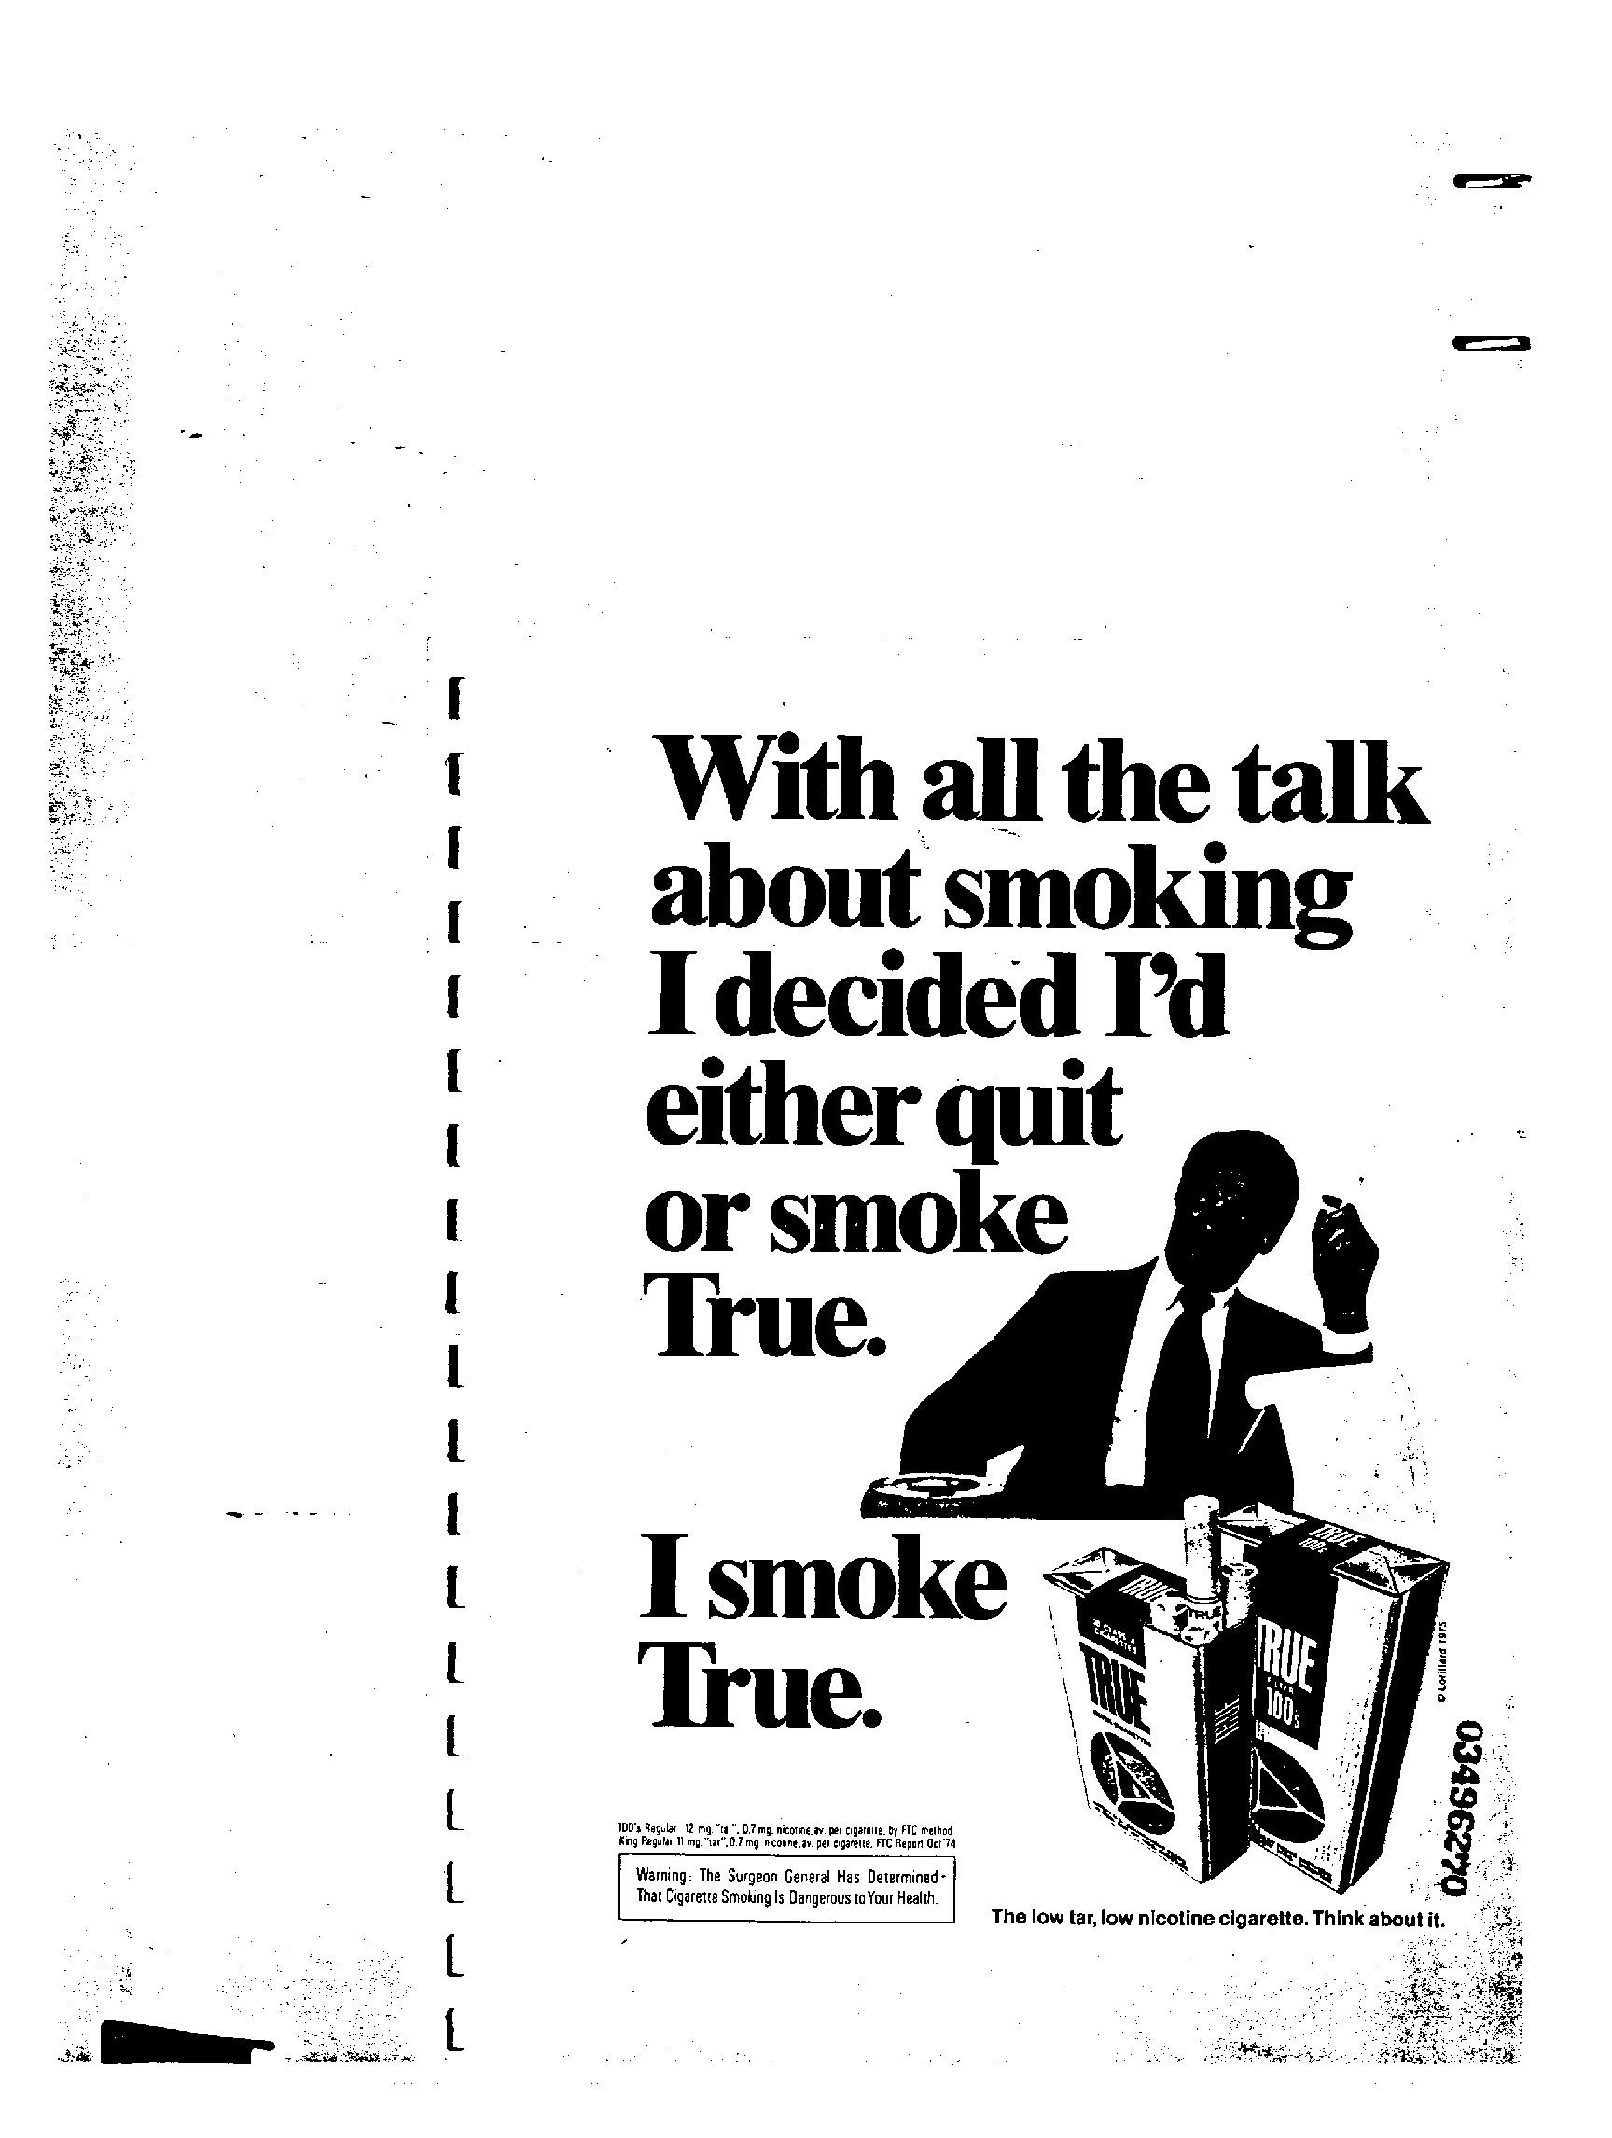
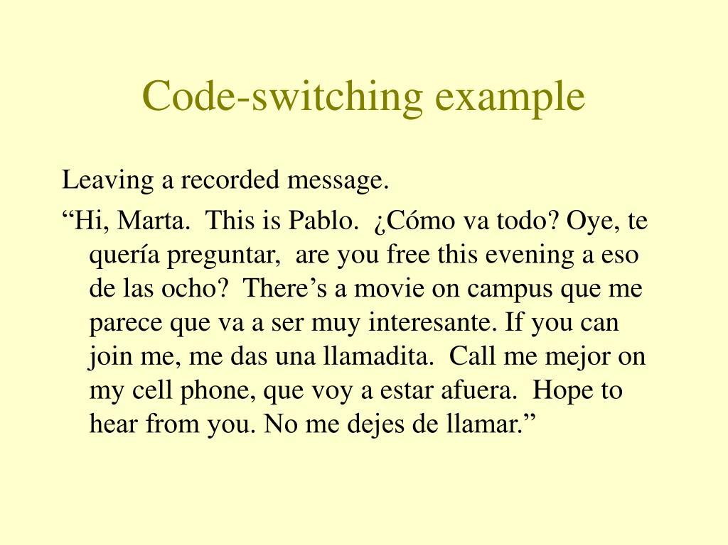
Pictures and multi-languages

Slide 17
Challenges of OCR
Accuracy depends on dataset quality. Some common sources of error include:
Age and damage (stained or blurry)
Mixed text and images, or multiple languages
Cursive fonts, handwriting
Human errors and typos

Slide 18
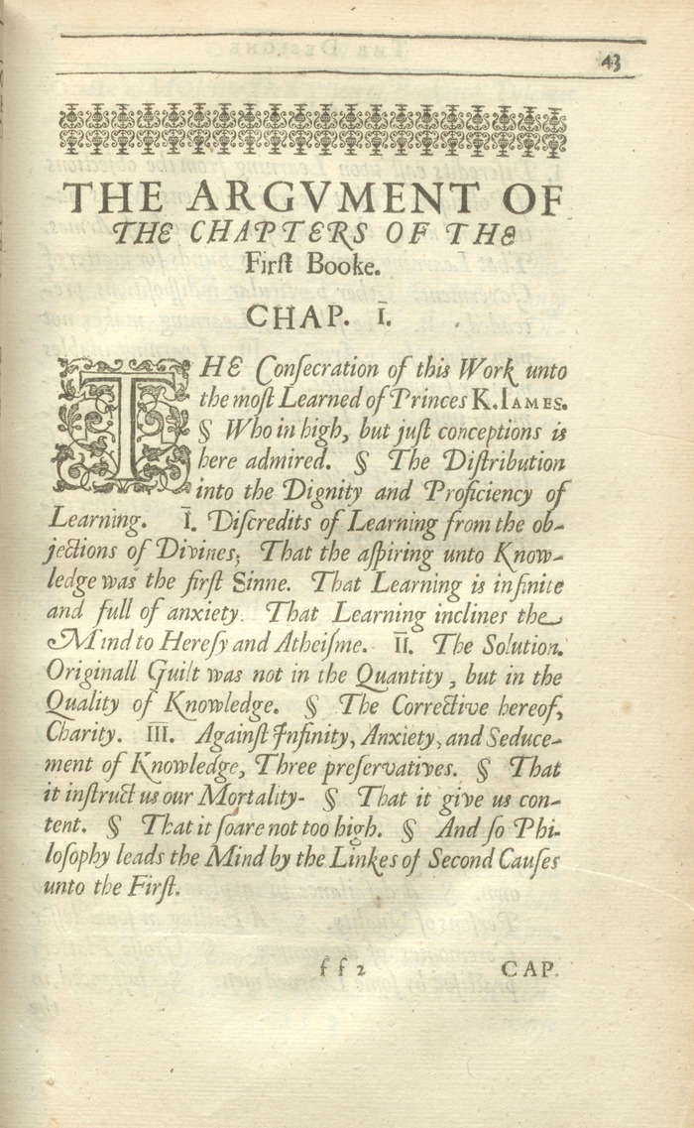
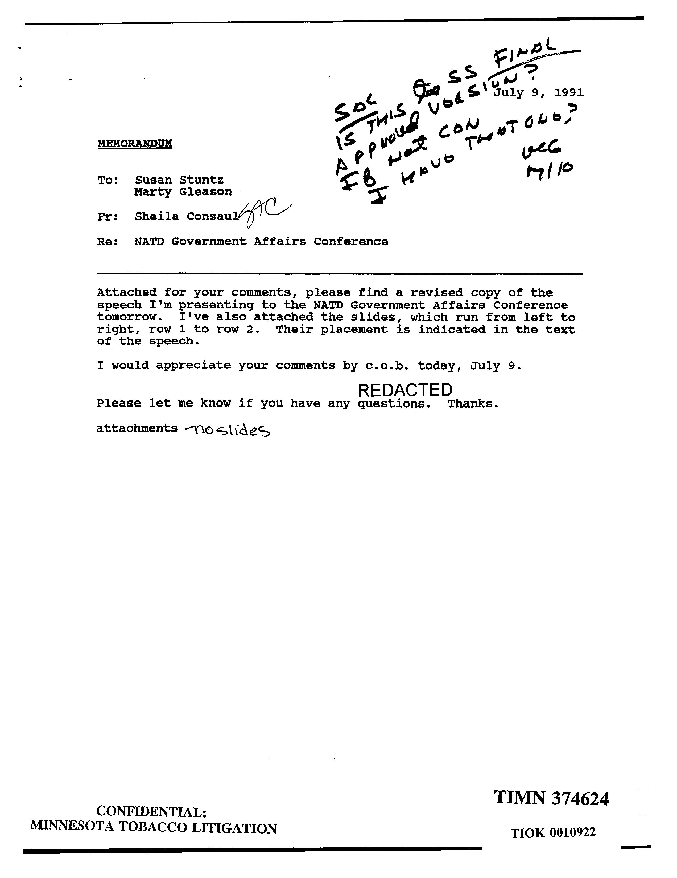
Cursive fonts, Handwritings

Slide 19
Challenges of OCR
Accuracy depends on dataset quality. Some common sources of error include:
Age and damage (stained or blurry)
Mixed text and images, or multiple languages
Handwriting
Human errors and typos

Slide 20
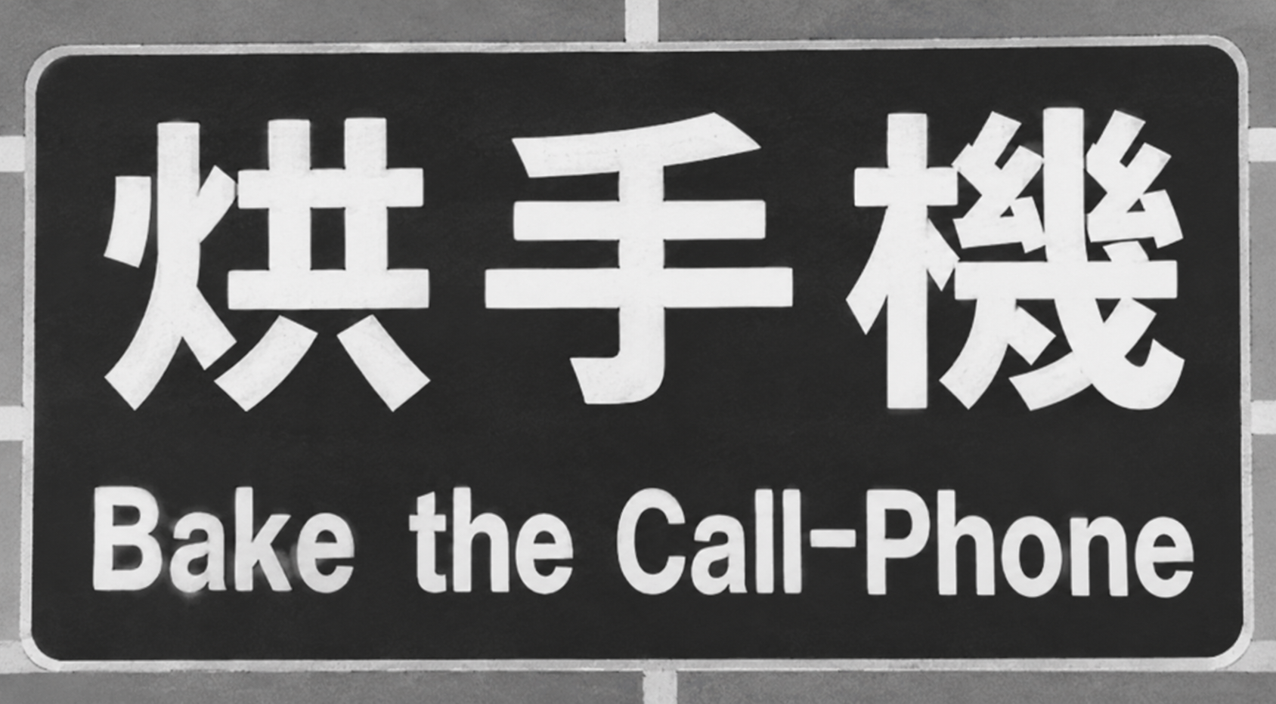
Human Errors - example

Slide 21
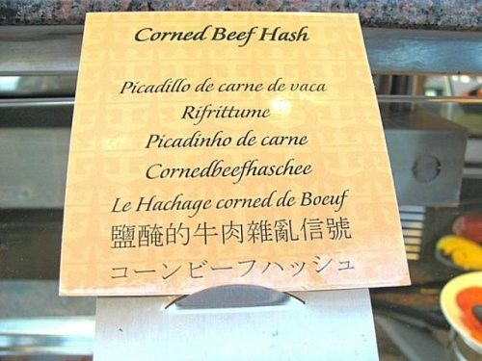
Human Errors - example

Slide 22
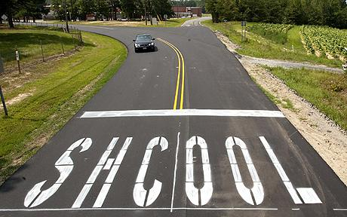
Human Errors - example

Slide 23
There is no universal solution….

Slide 24
Clean up the dataset before OCR
avoid rubbish in, rubbish out

Slide 25
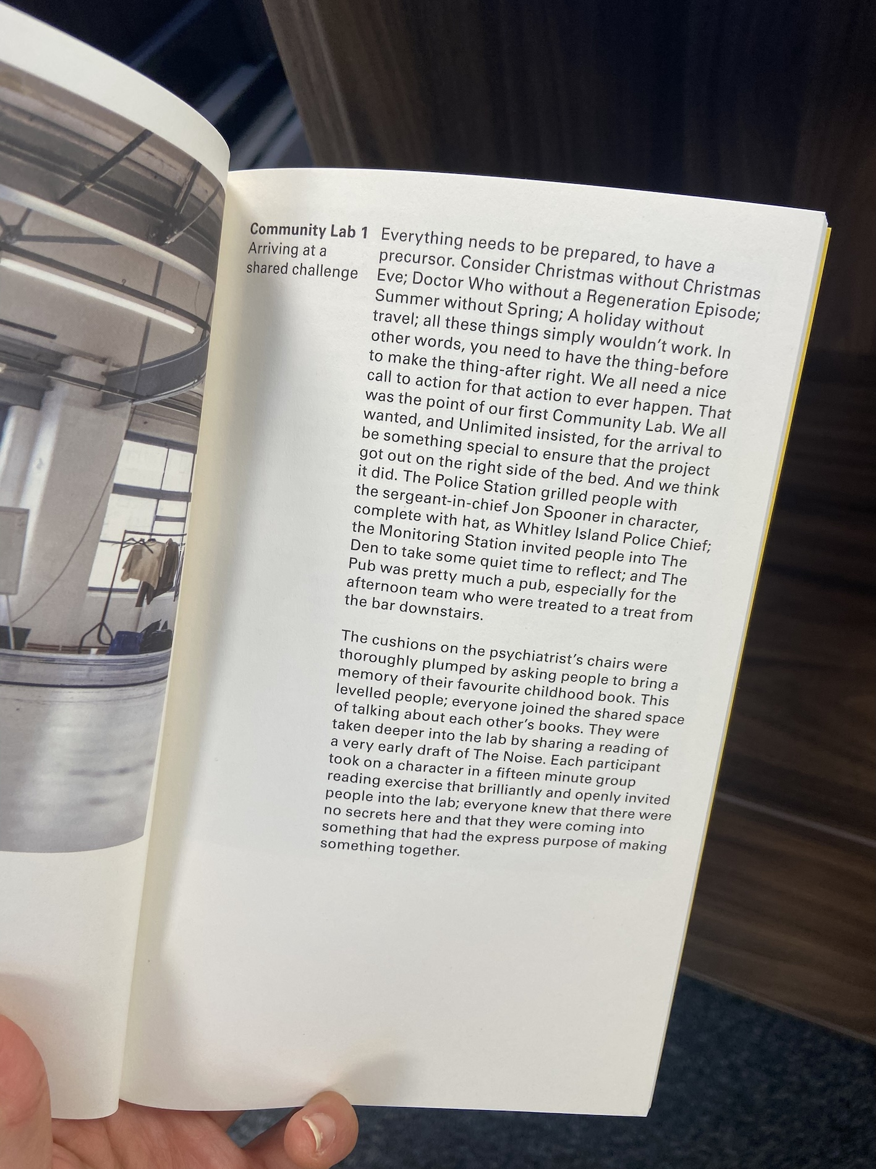
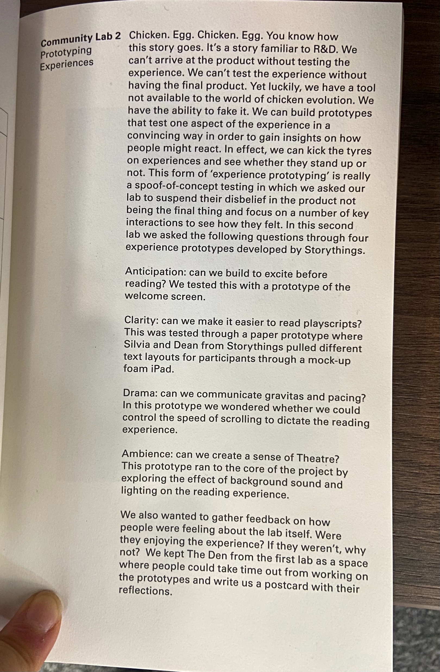
Inspect the data– scanning quality

Slide 26
Inspect the data– scanning quality
Image resolution
300 DPI is often used as a benchmark for good quality
printing reproducibility for photographs, but this may vary
Ex. National archive

Slide 27
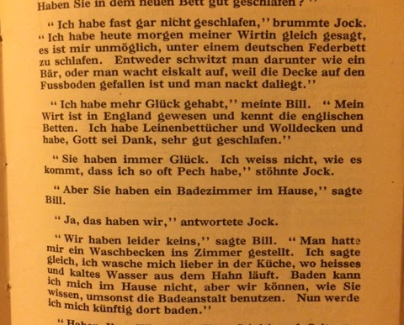
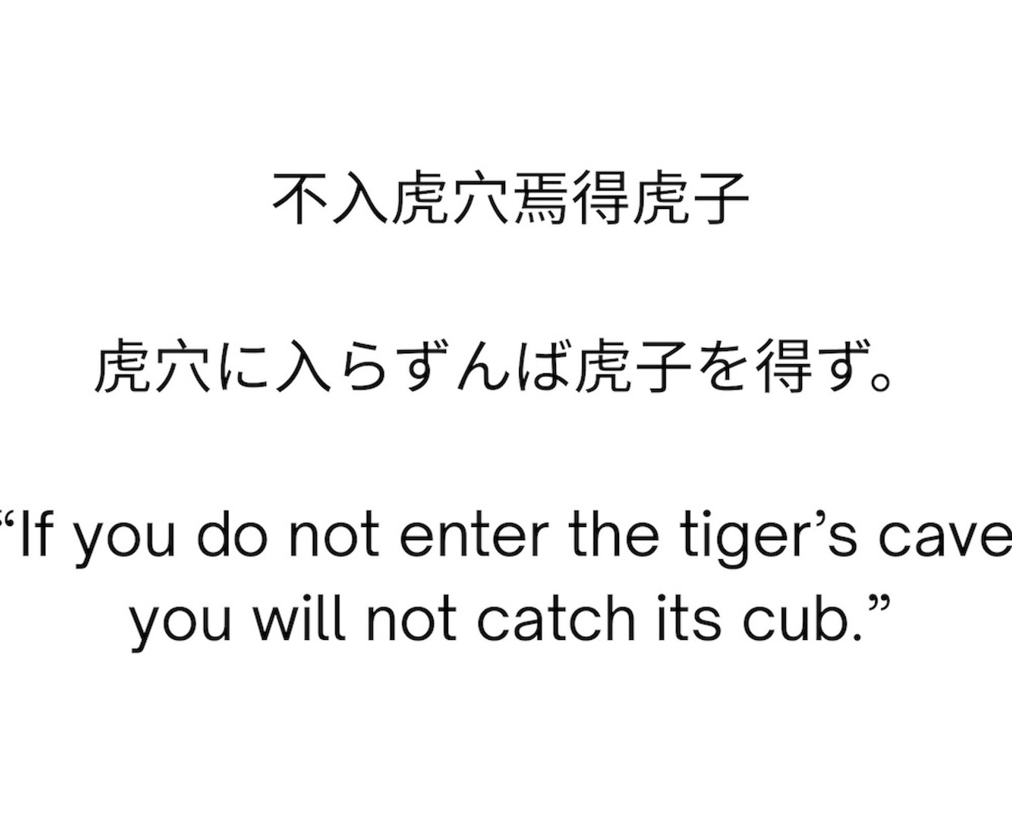
Inspect the image - language

Slide 28
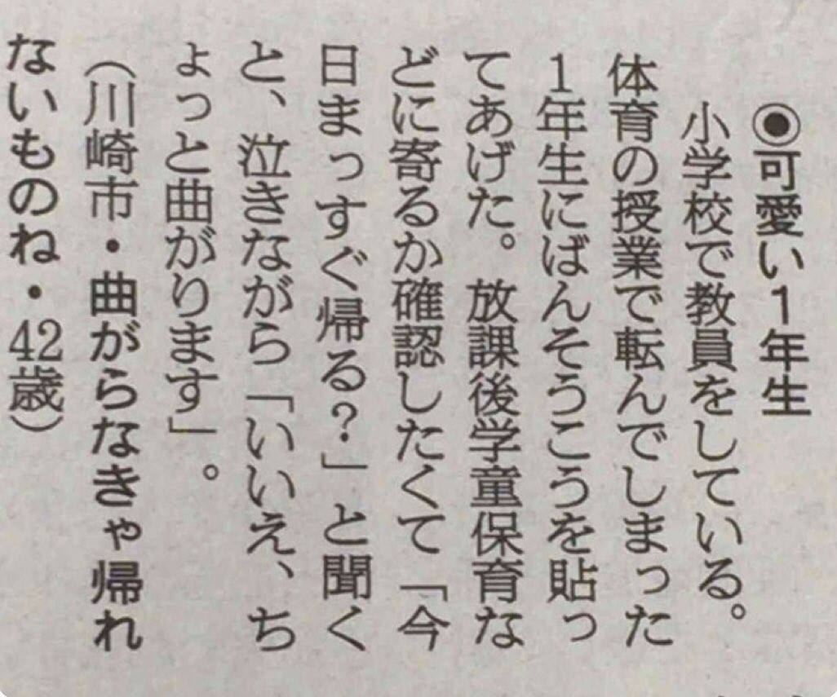
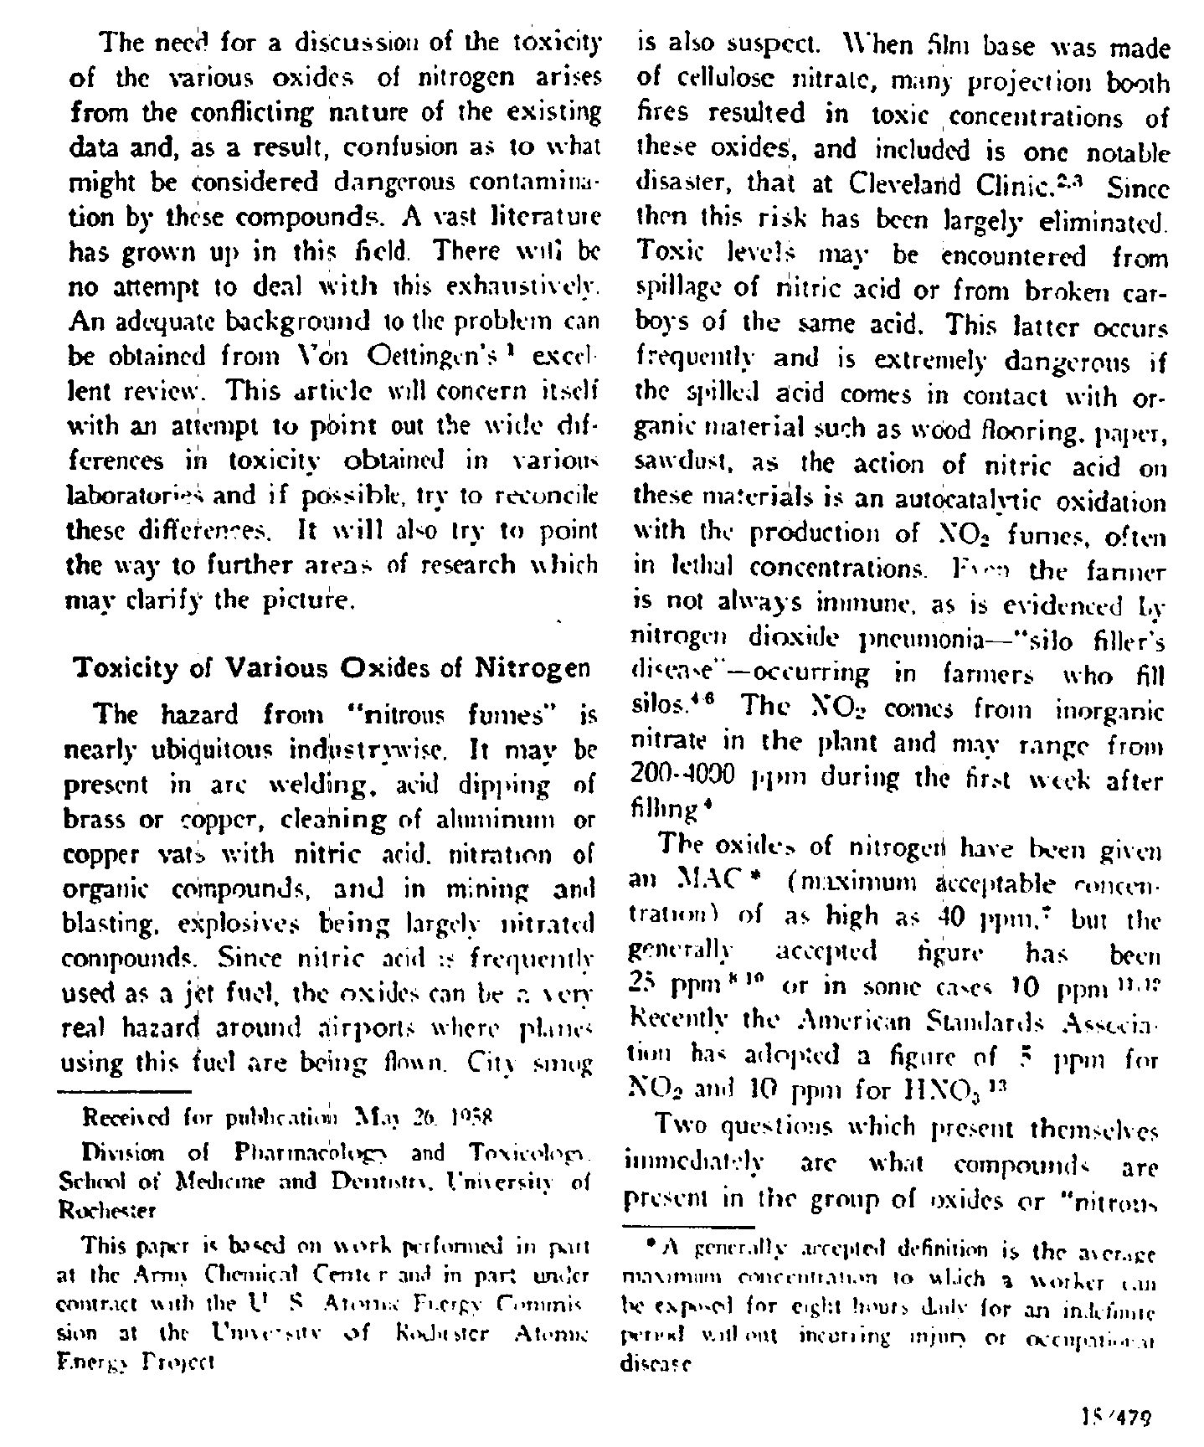
Inspect the image - typesetting
vertical
Multiple columns/ blocks

Slide 29
Coding – Python or R
Session 1a:
From Running to Writing

Slide 30
Clean up the dataset after OCR

Slide 31
Regex
Regex used in many different programming environments for pattern matching.
Use a sequence of characters to define a search to match strings
Match on types of characters and patterns to remove, or replace them

Slide 32
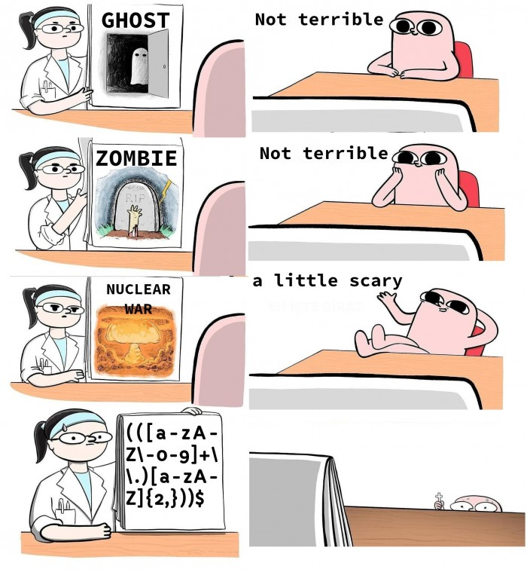
Regex

Slide 33
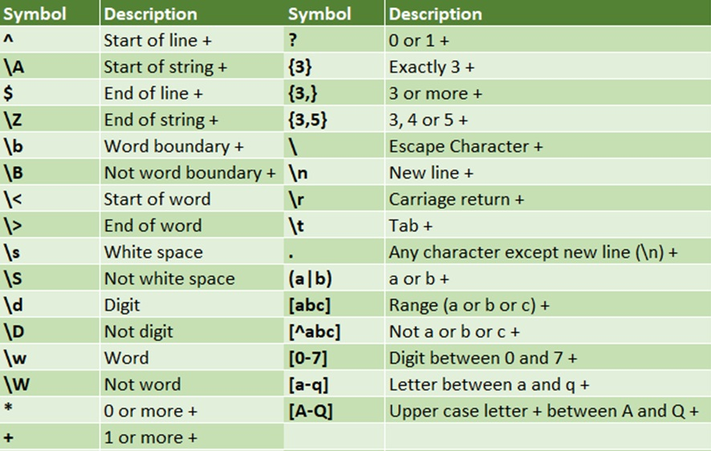
Regex
Useful sites for regex
https://programminghistorian.org/en/lessons/cleaning-ocrd-text-with-regular-expressions
https://programminghistorian.org/en/lessons/understanding-regular-expressions
https://librarycarpentry.org/lc-data-intro/01-regular-expressions/

Slide 34
M
Session 1a:
From Running to Writing

Slide 35
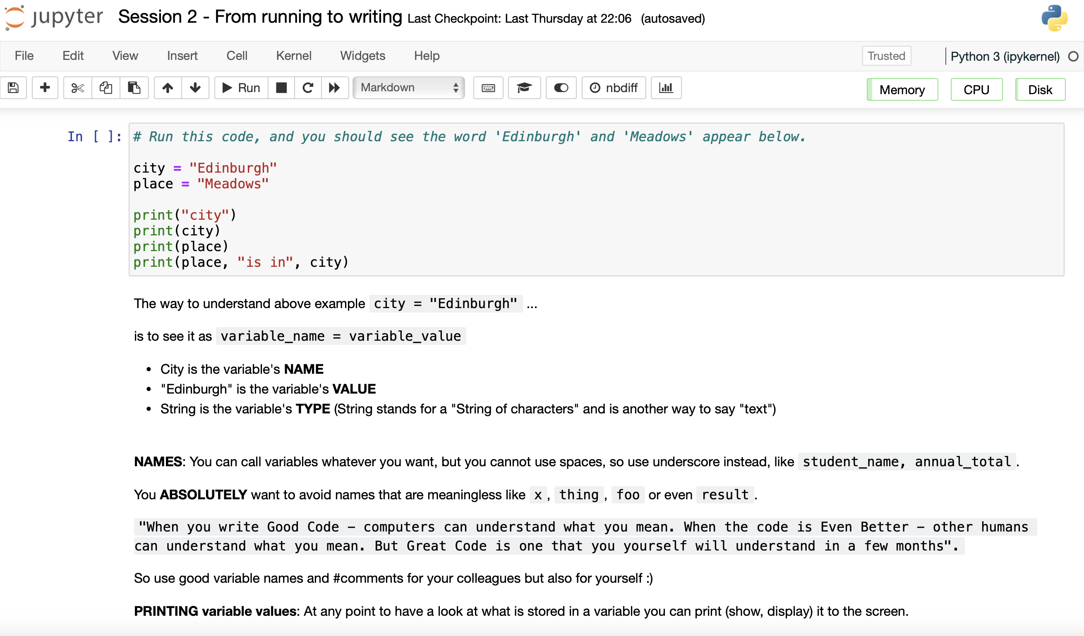
Jupyter Notebooks
}
Code (Python)
}
Text (Markdown)

Slide 36
Finishing Up

Slide 37
How to import data
To import data there is a range of methods, the easiest is using the package 'pandas'
Eg.
import pandas as pd
data_frame = pd.read_csv("<Your File Pathway>")

Slide 38
Additional Resources
This course used (slightly modified) notebooks from Code Storytelling (http://www.codestorytelling.com).
We covered badges 1,2,4,5,7, and 8. Consider working through some more of the notebooks and watching some of the videos.
Think Python is an introductory Python book with many exercises, free to read online: https://greenteapress.com/wp/think-python-2e/

Slide 39
Feedback for us
Feedback for us...
We hope you've enjoyed the course as much as we did.
It is really useful for us to hear your feedback
https://edin.ac/45BpZFm
Should be really quick and only take 5 mins (maximum!)

